Slide 1


Ennis, Texas
2023 Redistricting
Initial
Assessment
BICKERSTAFF HEATH DELGADO ACOSTA LLP
3711 S. MoPac Expressway
Building One, Suite 300
Austin, Texas 78746
(512) 472-8021
www.bickerstaff.com www.votinglaw.com
©2023
Notes:
Introduction – Attorney and Firm
The purpose of this presentation is to
Review the population of the councilmember districts based on the recently released 2010 Census
Review the City’s obligation to re-draw the boundaries of the six council districts so that the population in each of the six districts is balanced
Explain the legal requirements that come into play in that process
Explain how the City’s process will meet these legal requirements

Slide 2
REDISTRICTING
Applicable Law
“One person – one vote” (equal population)
Voting Rights Act § 2 (nondiscrimination)
Shaw v. Reno (limits use of race)
©2023

Slide 3
Redistricting
One Person - One Vote
U.S. Constitution – single-member districts must have approximately equal populations
Rule of thumb: total deviation < 10%
  Compare most populous and least populous districts to “ideal”–sized district
  Add both departures from ideal together
©2023
Notes:
City single-member districts are legislative districts that are subject to the one-person one vote requirements of the fourteenth amendment of the U.S. Constitution.
As such, each councilmember district must have equal population.
The release of the census figures each decade triggers the City’s obligation to review the councilmember districts and rebalance them if necessary.

Slide 4
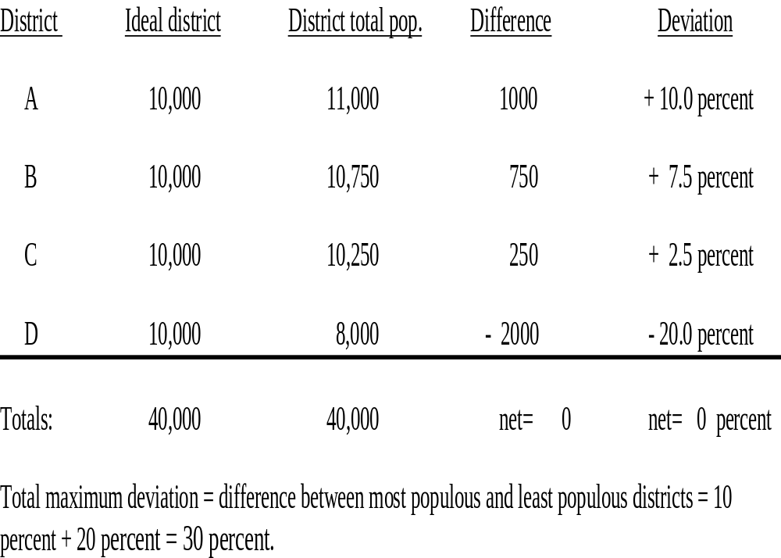
Example Deviation Calculation
©2023

Slide 5

Available Census Data
Available Census Data
PL94-171 File
  “Census block” level
    Total population
    VAP (voting age population)
    Race
    Hispanic origin
©2023
Notes:
On February 18, 2011 the Federal Census Bureau released the 2010 census data for Texas. This data is referred to as the PL94-171 data or Public Law data.
It is derived from the short form census reports which each of us filled out and filed with the agency last year.
The Public Law data includes certain demographic information and also includes voting age and total population figures that are specific down to the block level here at the City.
The census data that has been released contains the compilation of this demographic information. There are a number of racial categories that a person could have chosen on the census form, (White, African American/Black, Asian, American Indian/Alaska Native, Native Hawaiian or Other Pacific Islander, some other race or multiple race. In addition to selecting one or more racial categories there was one ethnic category on the census that could be selected which is Hispanic.
Accordingly, the census data that has been compiled and released by the U.S. Census Bureau is broken down into 288 different possible permutations of race and ethnicity.

Slide 6
What Population Do You Use?
Total Population
To determine one person - one vote
VAP
(Voting Age Population)
To measure voting rights issues
©2023
Notes:
To determine whether the council districts are in balance, we will utilize total population figures provided in the census data. This is the information that has been utilized by every political subdivision in the United States in submissions to the United States Department of Justice which reviews our changes.
To the extent that the City will need to analyze voting rights issues we will utilize the voting age population figures in the census and may also rely on Spanish Surnamed Registered Voter information and/or turnout information at the county election precinct level and other indicators of potential voting strength within the District.

Slide 7
Section 2 of the Voting Rights Act
No discrimination on basis of race or language minority status
Generally, avoid cracking or packing
Cracking or fracturing is dividing minority voters to fragment their voting power.
Packing is concentrating minority voters when dividing them would permit the group to elect their candidates of choice in more than one district
Other practices can also violate Section 2
©2023
Notes:
Discuss

Slide 8
14th Amendment
(Shaw v. Reno)
Limits race-based decision making, including redistricting
Was race the predominant consideration in drawing a redistricting plan?
If so, is the plan a narrowly tailored means of addressing a compelling governmental interest?
©2023
Notes:
Once we determine our Section 5 and Section 2 issues, then we must examine the countervailing principle which is the Shaw v. Reno line of cases.

Slide 9
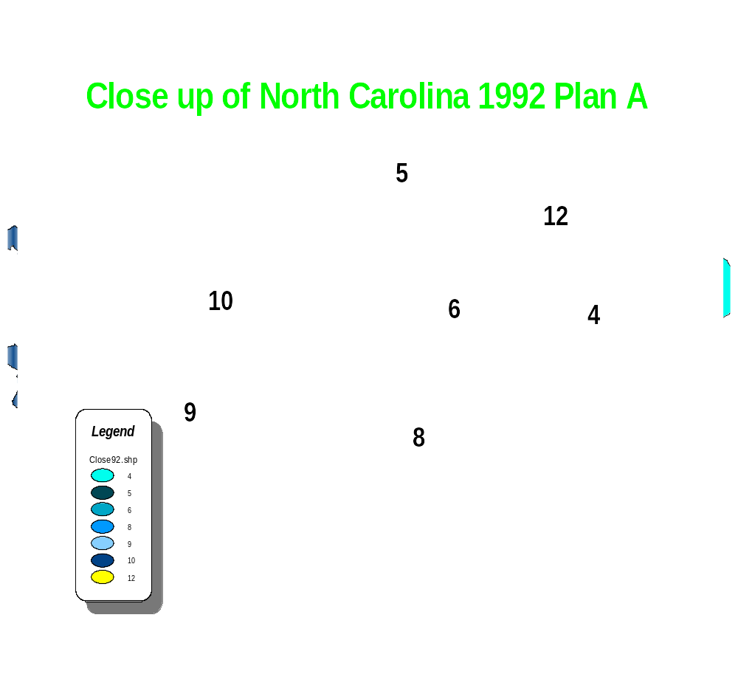
CLOSE UP OF NORTH CAROLINA 1992 PLAN A
©2023
Notes:
Describe classic Shaw v. Reno example along expressway picking up all census blocks with predominately African American population to build a district.

Slide 10
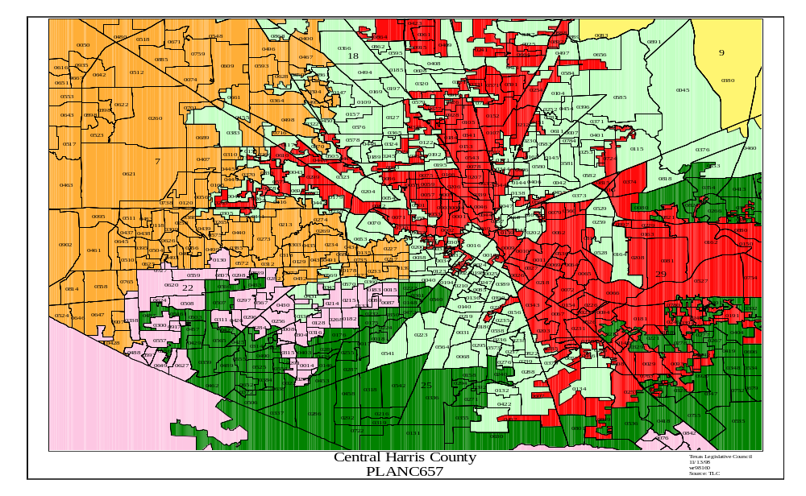
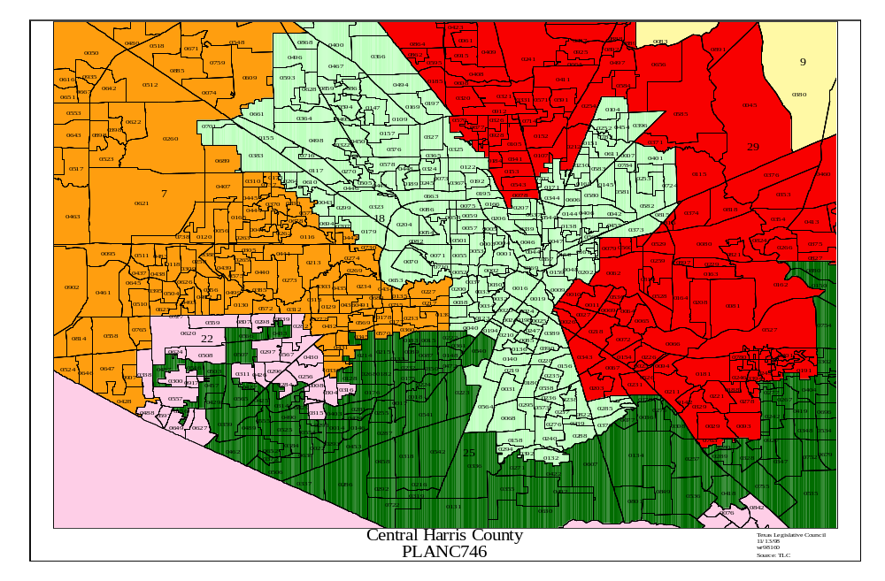
Bush v. Vera
Before
After
©2023
Notes:
Describe example where court declared plan (top) as violation of principles in Shaw v. Reno and then adopted more compact version (bottom)

Slide 11
Adopt Criteria
Identifiable boundaries
Maintaining communities of interest & neighborhoods
Using whole voting precincts, if possible
Basing plan on existing Wards
Adopting wards of relatively equal size
Drawing wards that are compact and contiguous
Keeping existing incumbents in their wards
Narrowly tailoring plan to comply with the VRA
©2023
Notes:
Explain how we have proposed criteria for consideration by the Commissioners Court. Here are notes on various elements:
Compactness has geographic and functional dimension. A district, even when not geographically compact, can be functionally compact depending on such matters as:
Voting patterns
Income
Education
Home ownership
The availability of transportation and communication
The existence of common social and economic interest
The ability of the constituents to relocate to each other
Examples of easily identifiable geographic boundaries
Highways
Major roads
Rivers
Creeks
Bridges
Golf courses
Stadiums
Parks
Cemeteries
College campuses
Hospitals
Race tracks
Other public buildings & landmarks
Whole Voting Precinct Notes
Prevent and eliminate voter confusion by taking into consideration the boundaries created for other public purposes.
Draw based on existing voting precincts as established by the county.
Notes on keeping incumbents in district
Preserve the will of the voters
Provide consistency in the incumbent-constituent relationship.

Slide 12

Plan Development Elements
(Subject to Charter Amendment)
Initial Assessment
Adopt plan criteria, guidelines
Develop illustrative plan(s)
Public comment / hearing
Analyze comments
Adopt final plan
Implementation
©2023

Slide 13

Proposed 2023 Redistricting Timeline for City of Ennis, Texas
2023
Feb
Mar
Apr
May
Jun
Jul
Redistricting Process
Redistricting Plan Adopted by City Council submitted to County Election’s Staff for updating voter coding
Public Hearing & Comments;
Assessment of Plans
Prepare Initial Assessments
Compile City
Information
Adopt Final Plan
Drawing Session #2
Drawing Session #1
Overview of Process and Legal Issues
Adopt Rules, Criteria
Present Initial Assessment
First Public Hearing for Public Input
Review and Revise a Proposed Plan Based Upon Public Comment
©2023

Slide 14

Ennis, Texas
Benchmark with 2020 Census Data
©2023
Notes:
Discuss the data.

Slide 15
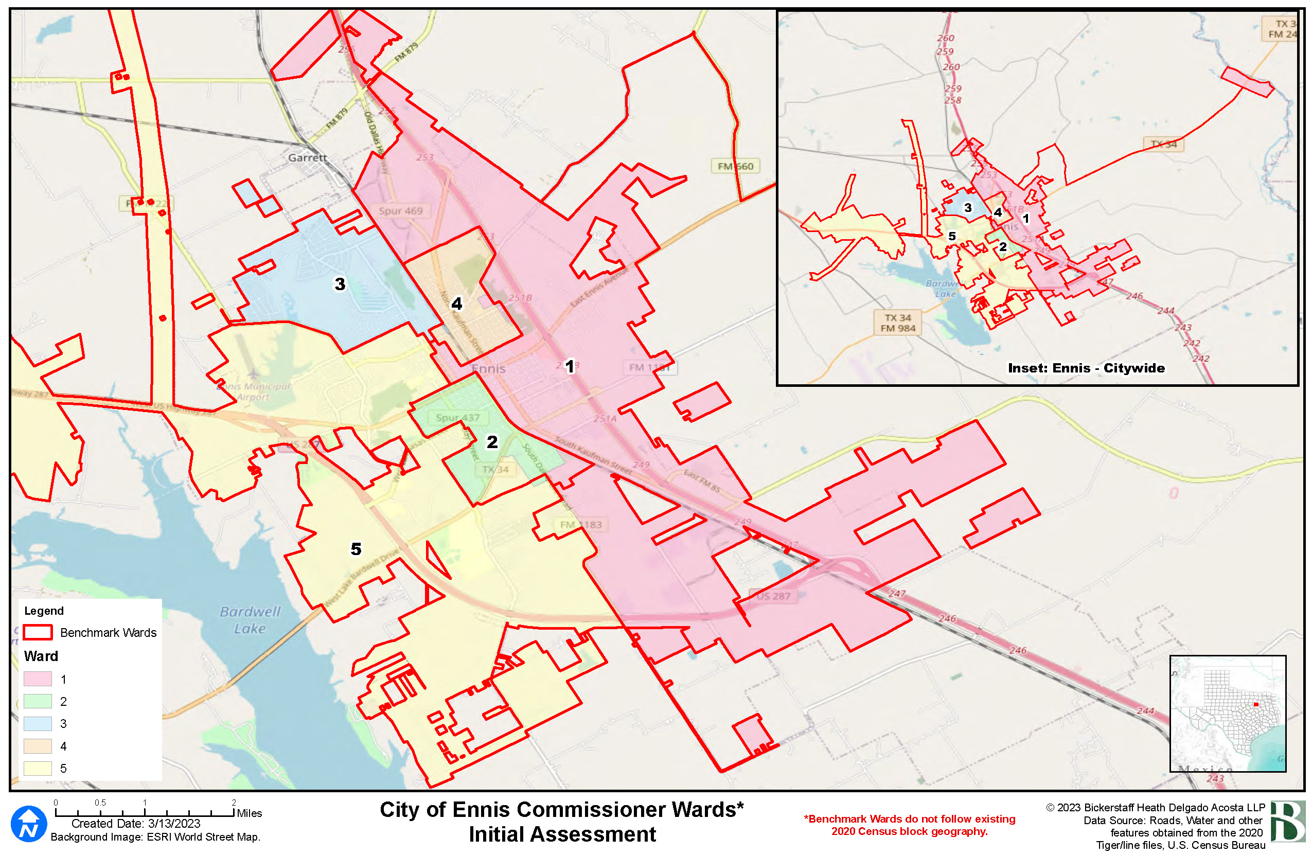
Current Commissioner Wards
INSERT MAP
©2023

Slide 16
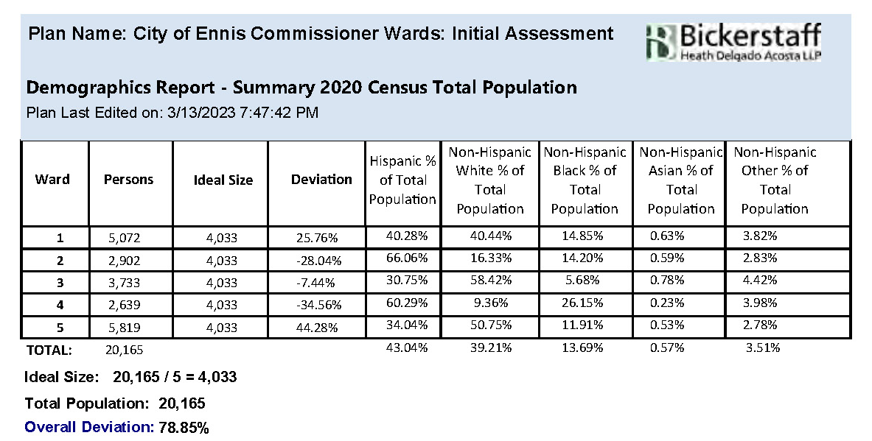
City of Ennis
Total Population For Current Wards Using 2020 Census Data
INSERT TABLE(S) HERE
©2023

Slide 17
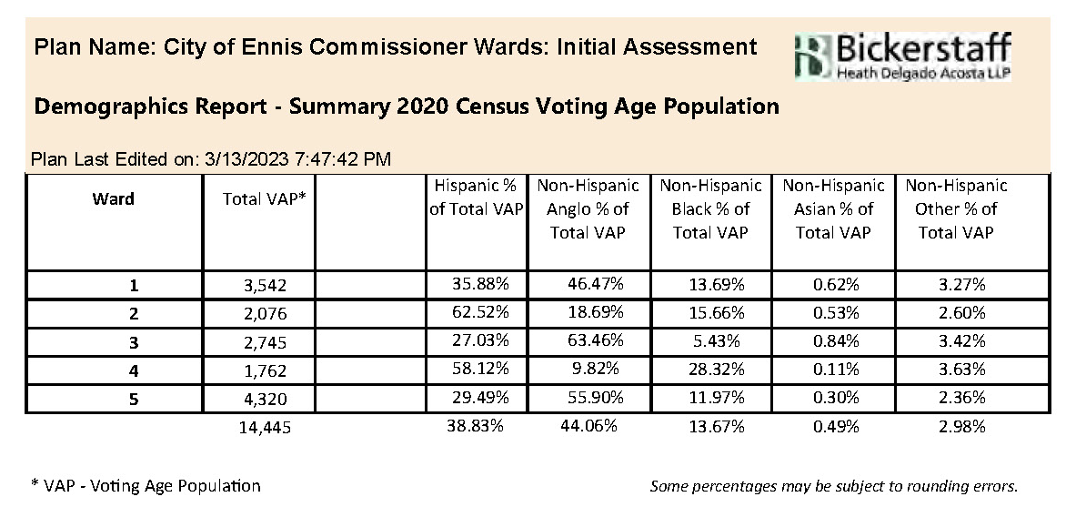
City of Ennis
Voting Age Population For Current Wards Using 2020 Census Data
INSERT TABLE(S) HERE
©2023

Slide 18
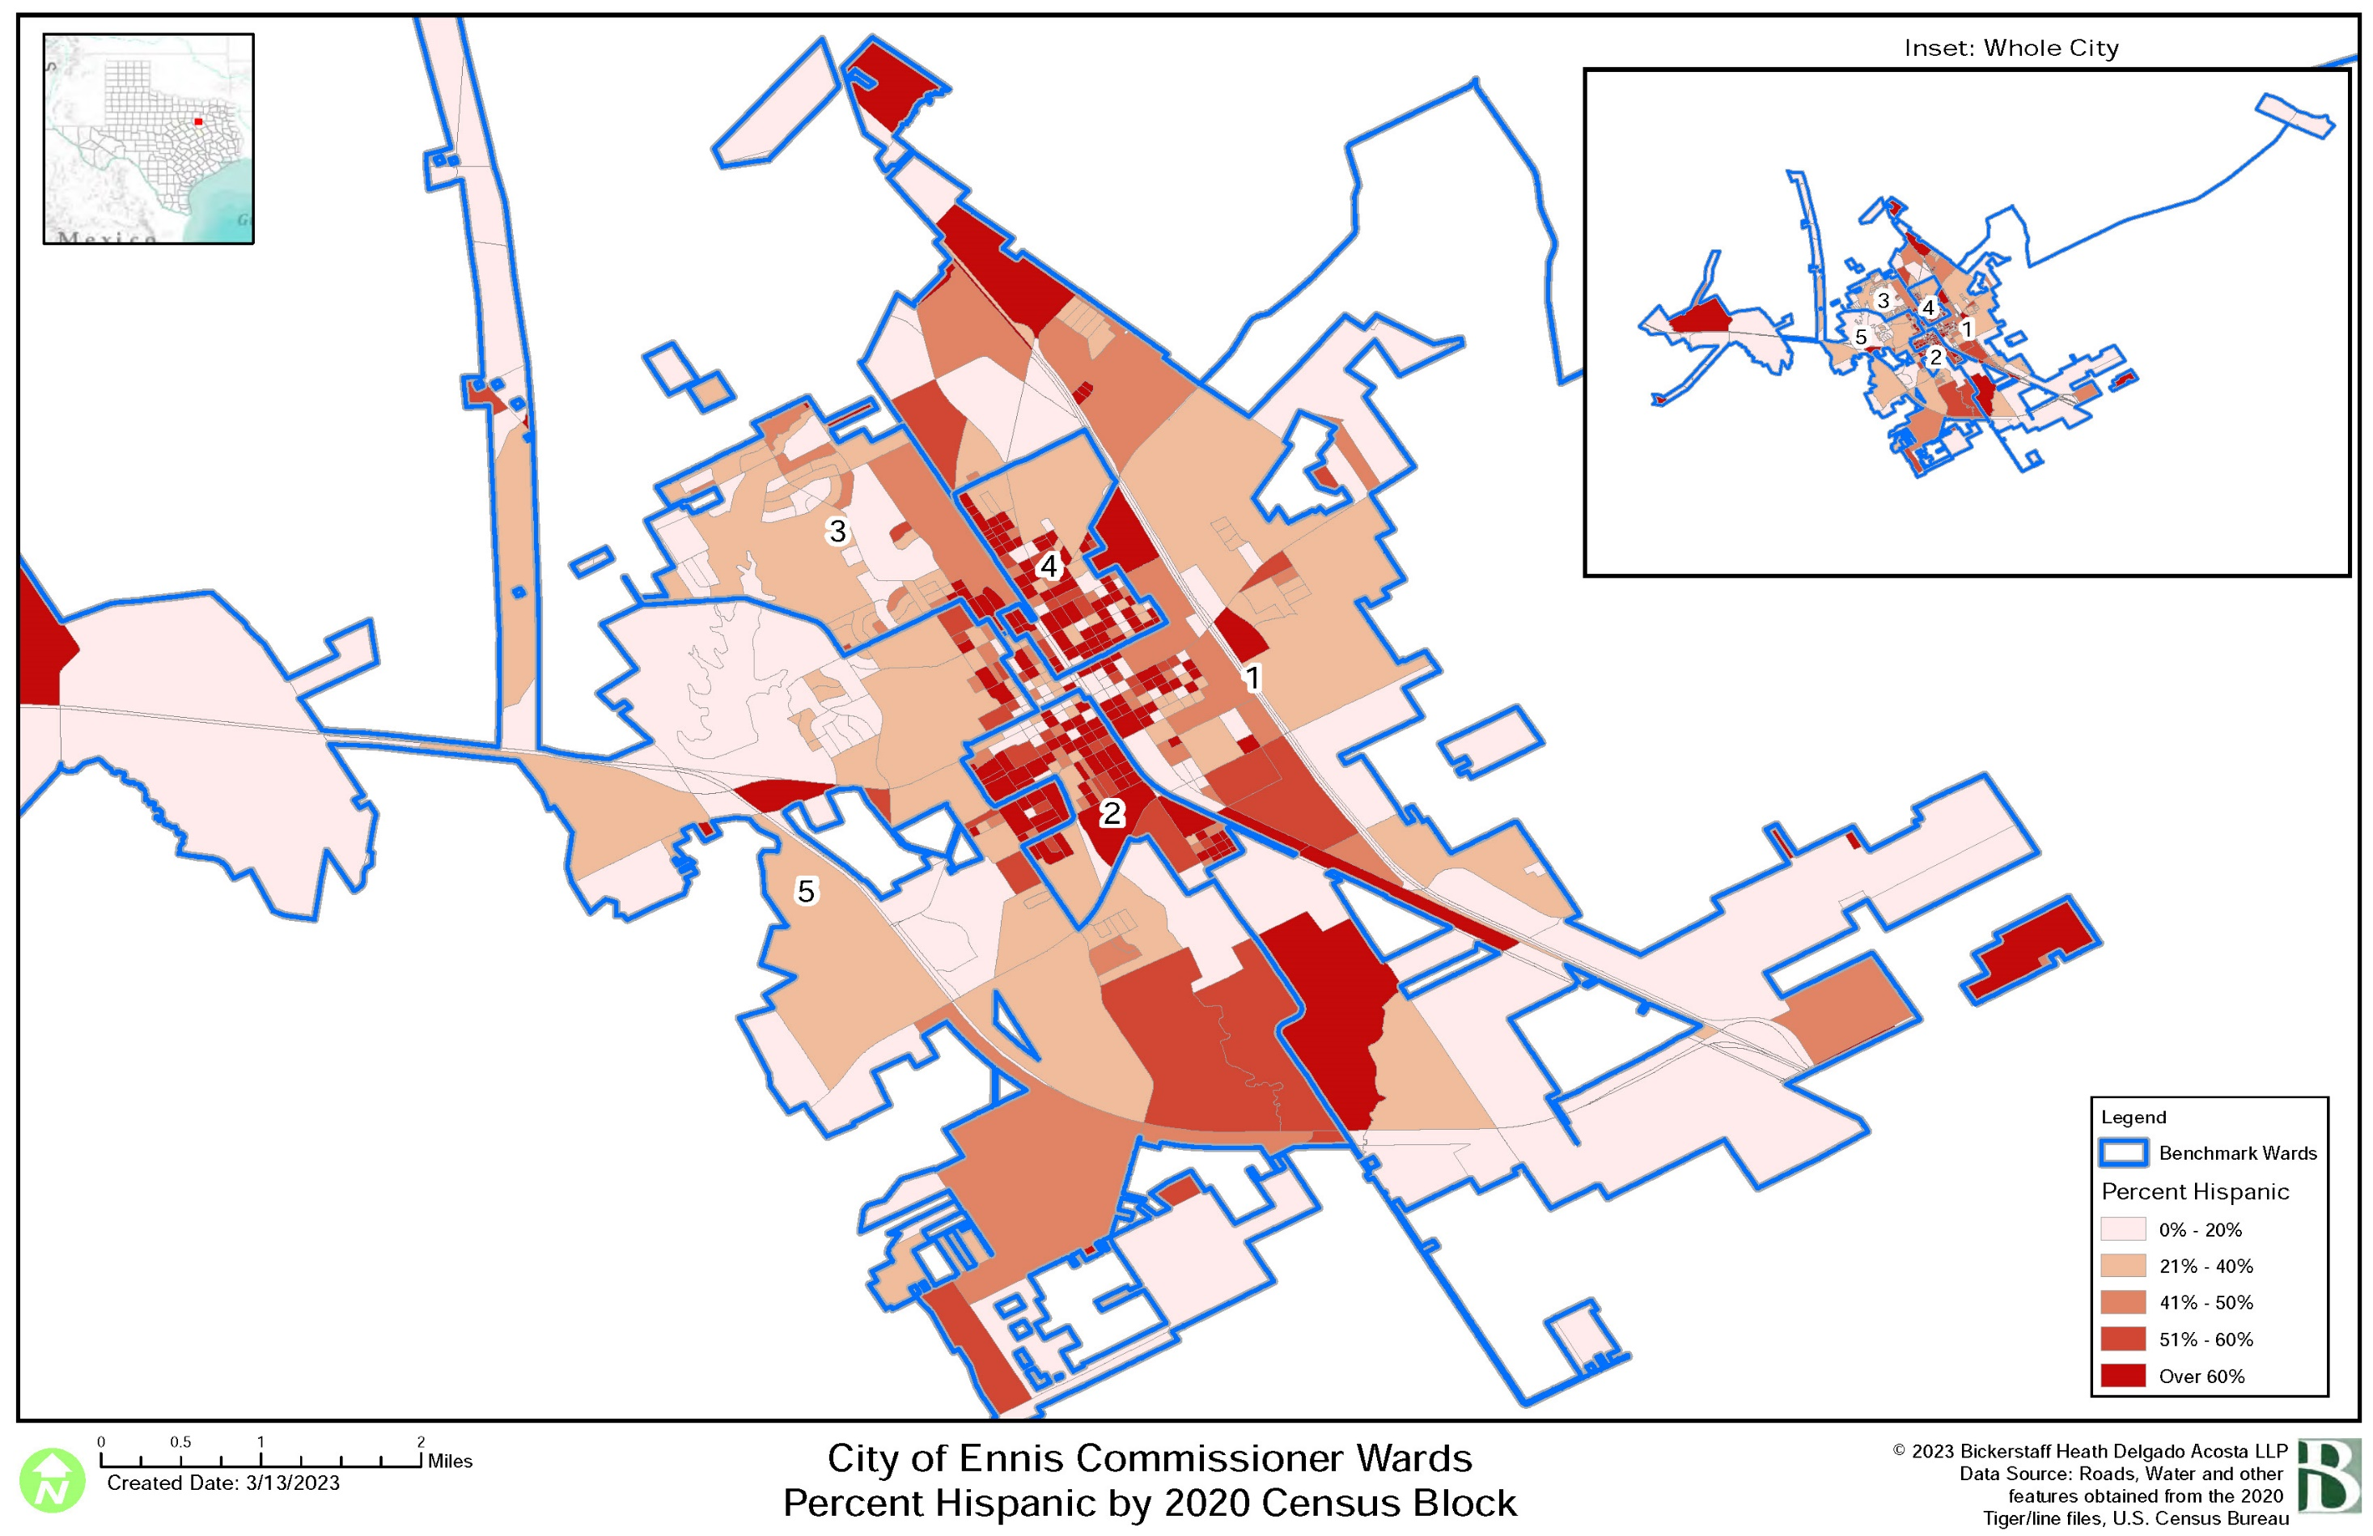
Thematic Maps
©2023

Slide 19
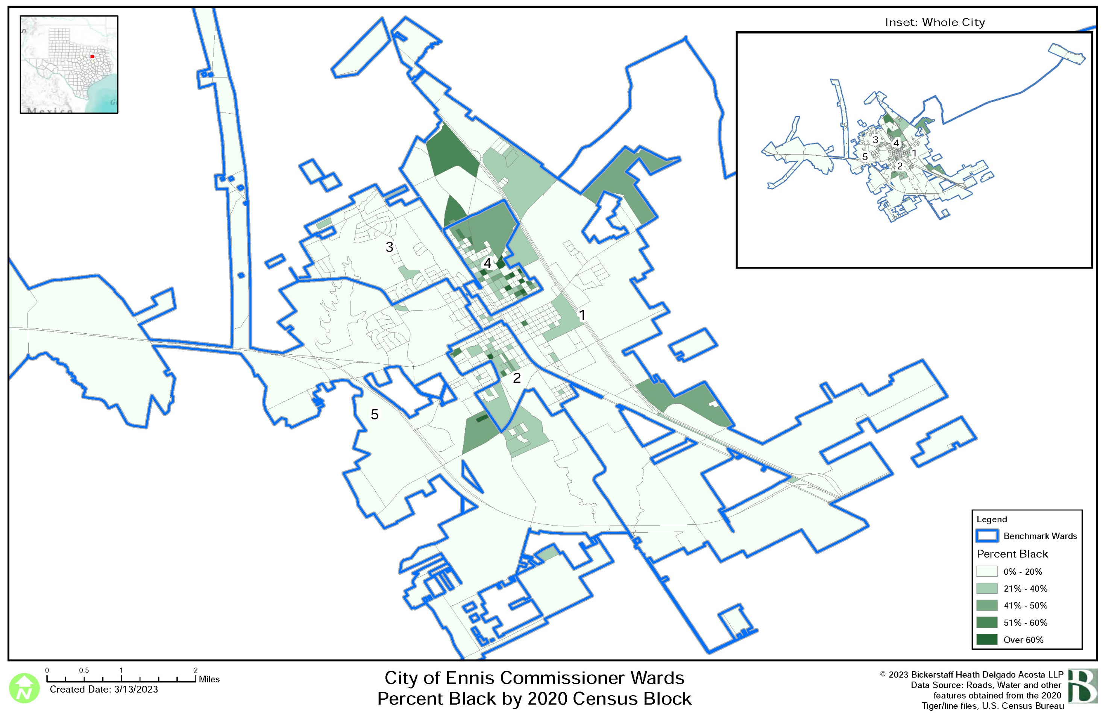
Thematic Maps
©2023

Slide 20

Questions
This Photo by Unknown Author is licensed under CC BY
©2023

Slide 21
Ennis, Texas
2023 Redistricting
Initial
Assessment
BICKERSTAFF HEATH DELGADO ACOSTA LLP
3711 S. MoPac Expressway
Building One, Suite 300
Austin, Texas 78746
(512) 472-8021
www.bickerstaff.com www.votinglaw.com
©2023
Notes:
Introduction – Attorney and Firm
The purpose of this presentation is to
Review the population of the councilmember districts based on the recently released 2010 Census
Review the City’s obligation to re-draw the boundaries of the six council districts so that the population in each of the six districts is balanced
Explain the legal requirements that come into play in that process
Explain how the City’s process will meet these legal requirements

